Slide 1
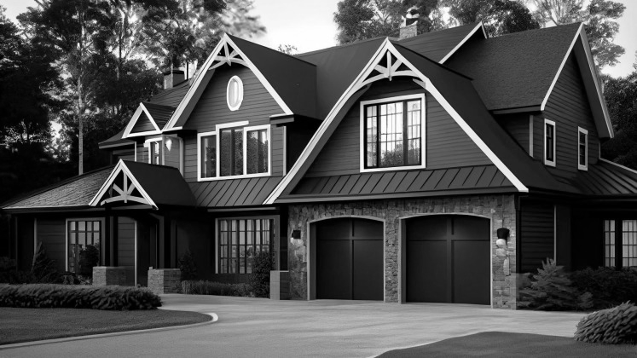
HOME CREDIT
DEFAULT RISK

Slide 2


TEAM MEMBERS
GROUP 7
NISHI
TAYADE
GAUTAM
NAIR
SANKET
JANOLKAR
SARVESH
KELUSKAR

Slide 3

BUSINESS PROBLEM
“
PROBLEM
“
Challenges in extending loans to individuals with limited credit history hinder the achievement of our financial inclusion mission.
APPROACH
Predicting the ability of home loan applicant to repay the loan
- GROUP 7

Slide 4

DATASETS
Prediction Dataset
Application Train Set
Application Test Set
Client’s Credit History Dataset
Bureau
Bureau Balance
Previous Application
Installment Payments
Credit Card Balance
POS Cash Balance
- GROUP 7

Slide 5

TARGET VARIABLE
TARGET ‘0’
Majority Class
91.9% - Non Defaulters
NON-DEFAULT
91.9%
TARGET ‘1’
DEFAULT
8.1%
Minority Class
8.1% - Defaulters

Slide 6




STATISTICAL APPROACH
FEATURE
ENGINEERING
MODEL
DEPLOYMENT
EDA
PREDICTIONS

Slide 7
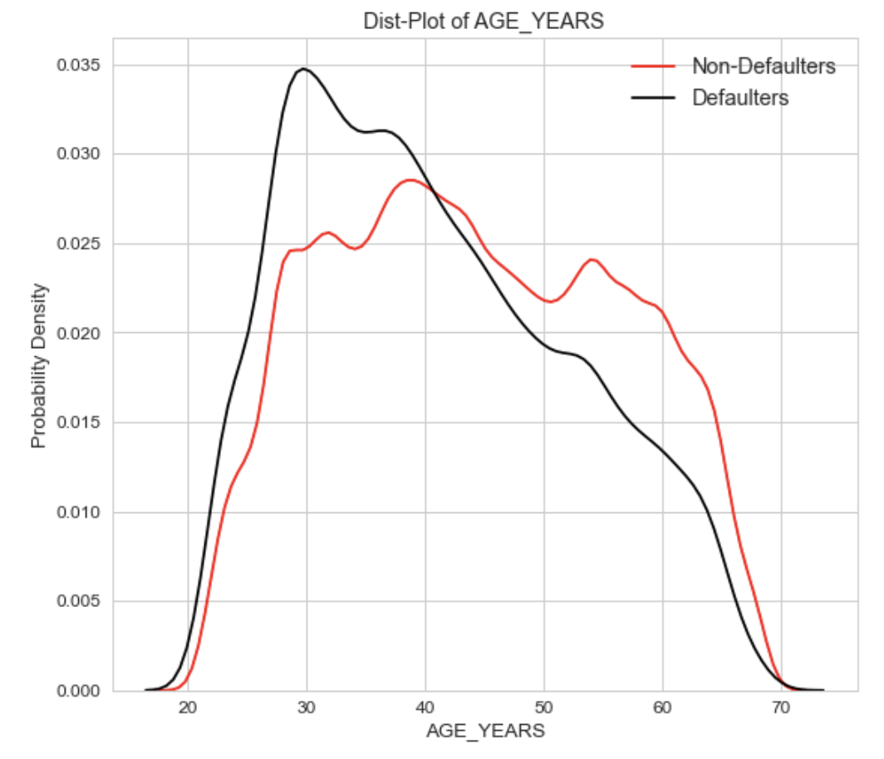
PREDICTOR ANALYSIS
Age
Peak of Defaulter at 30 years
Smaller probability density function for non-defaulters
Defaulters younger than Non-Defaulters

Slide 8
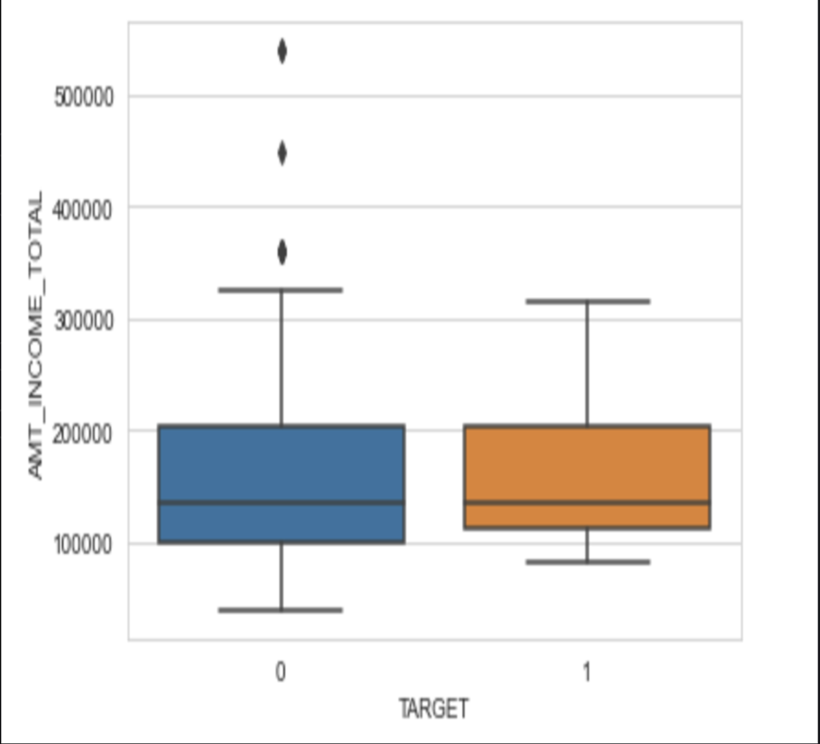
PREDICTOR ANALYSIS
Income
No major effect on Default Classification
Both classes have similar income brackets
Few outliers for the non-defaulters which needs to be ignored.

Slide 9
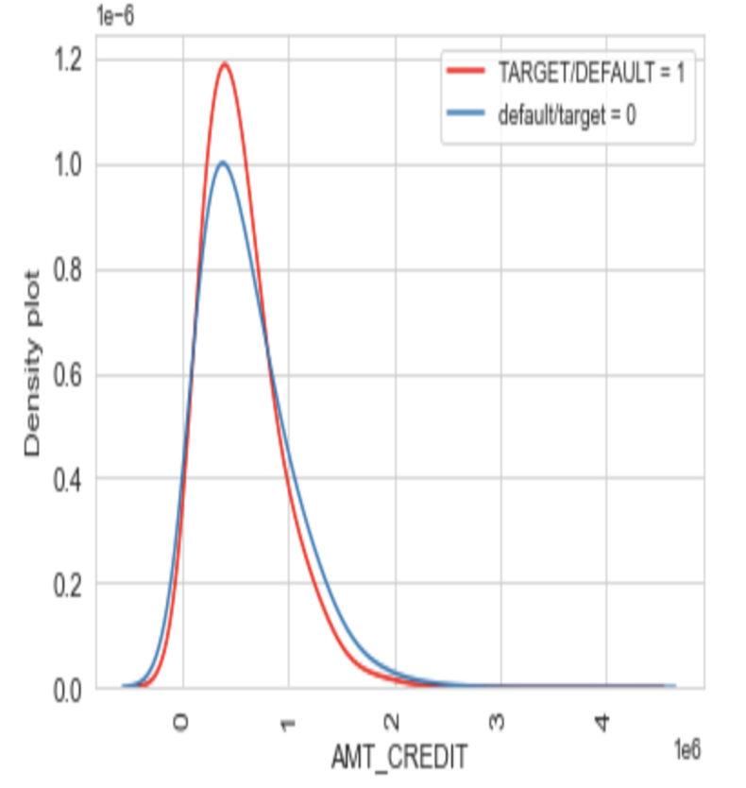
PREDICTOR ANALYSIS
Amount Credit
Both target classes have a peak between 0 and 1, hence no much effect.
Smaller probability density function for non-defaulters
Non-defaulters have less amount of credit provided.

Slide 10
MODEL EVALUATION
RANDOM
FOREST
LOGISTIC REGRESSION
EXTREME
GRADIENT BOOST
LIGHT
GRADIENT BOOST
AUC
SCORE
0.50
0.59
0.71
0.75
KAGGLE
SCORE
0.53
0.54
0.74
0.75

Slide 11
MODEL PERFORMANCE
CONFUSION MATRIX
0.94
51366
5188
PRECISION
0
0.91
RECALL
3184
1765
1
0.92
F-1 SCORE
0
1

Slide 12

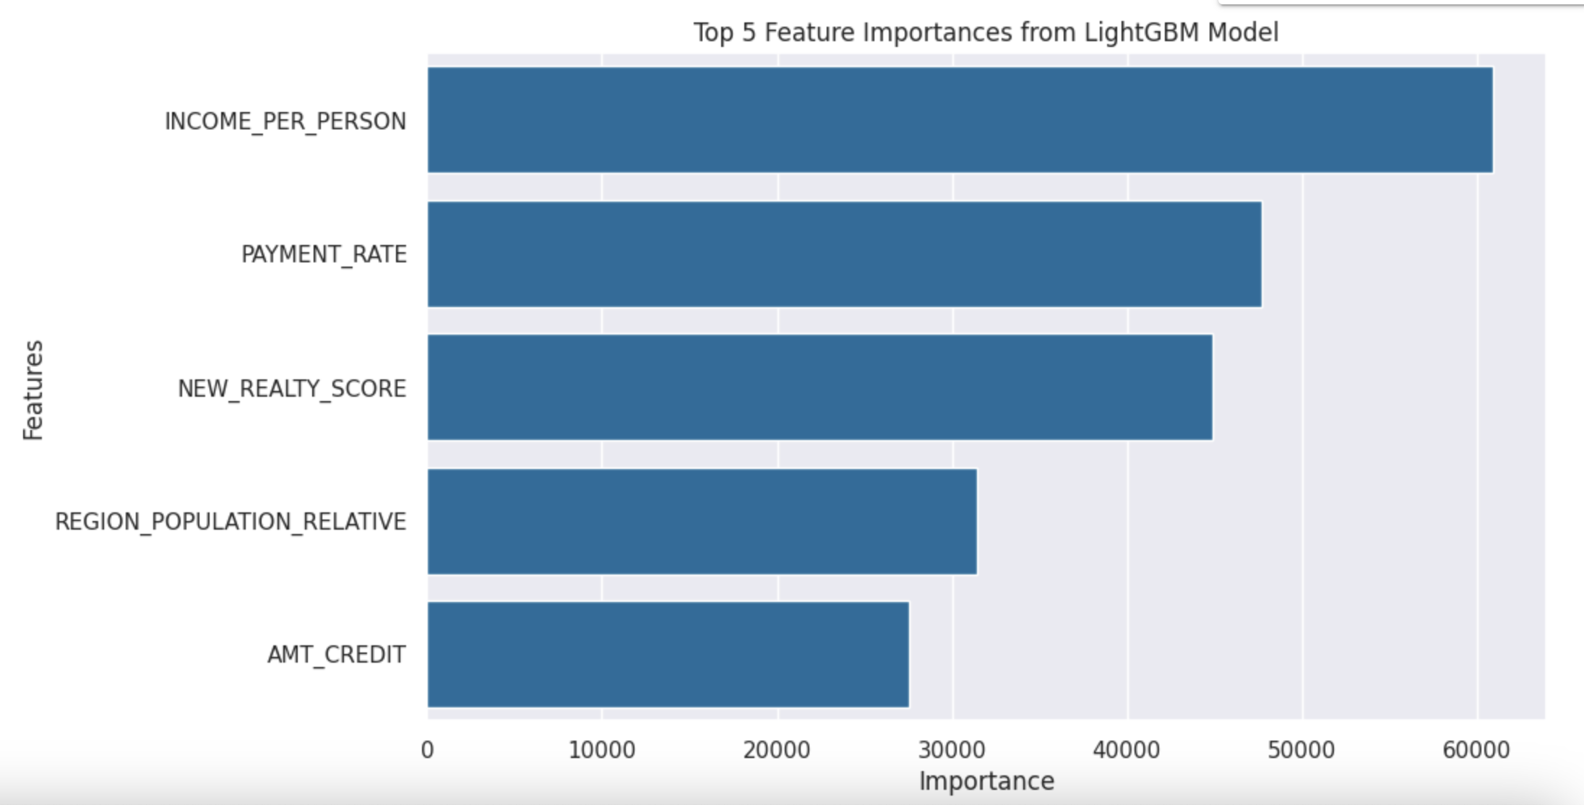
CONCLUSION
TOP 5 FEATURE IMPORTANCES FROM LGB MODEL
Age – A key factor while consider default probability
Payment_Rate - Payment of Loan Installments
Realty_Score – Metric to determine property value
Amt_Goods_Price – The cost of goods that is offered on credit
Amt_Credit – Amount of Credit utilized
AGE
PAYMENT_RATE
NEW_REALTY_SCORE
AMT_GOODS_PRICE
AMT_CREDIT

Slide 13
RECOMMENDATIONS
Generate Probability of Default (PD)
Risk Adjusted Return on Capital (RAROC)
Ratio of Expected Return(ER) to Economic Capital: (EC)
RAROC = (ER-EL)/ EC
Compare RAROC values for loan applications to prioritize higher expected returns considering risk.
Establish RAROC thresholds aligned with risk appetite and business goals.

Slide 14
THANK YOU

